Slide 1
Technical English for Computer Science
Week 13
Dr. Nur Banu OĞUR

Slide 2
THE HAUNTED HOUSE

Slide 3
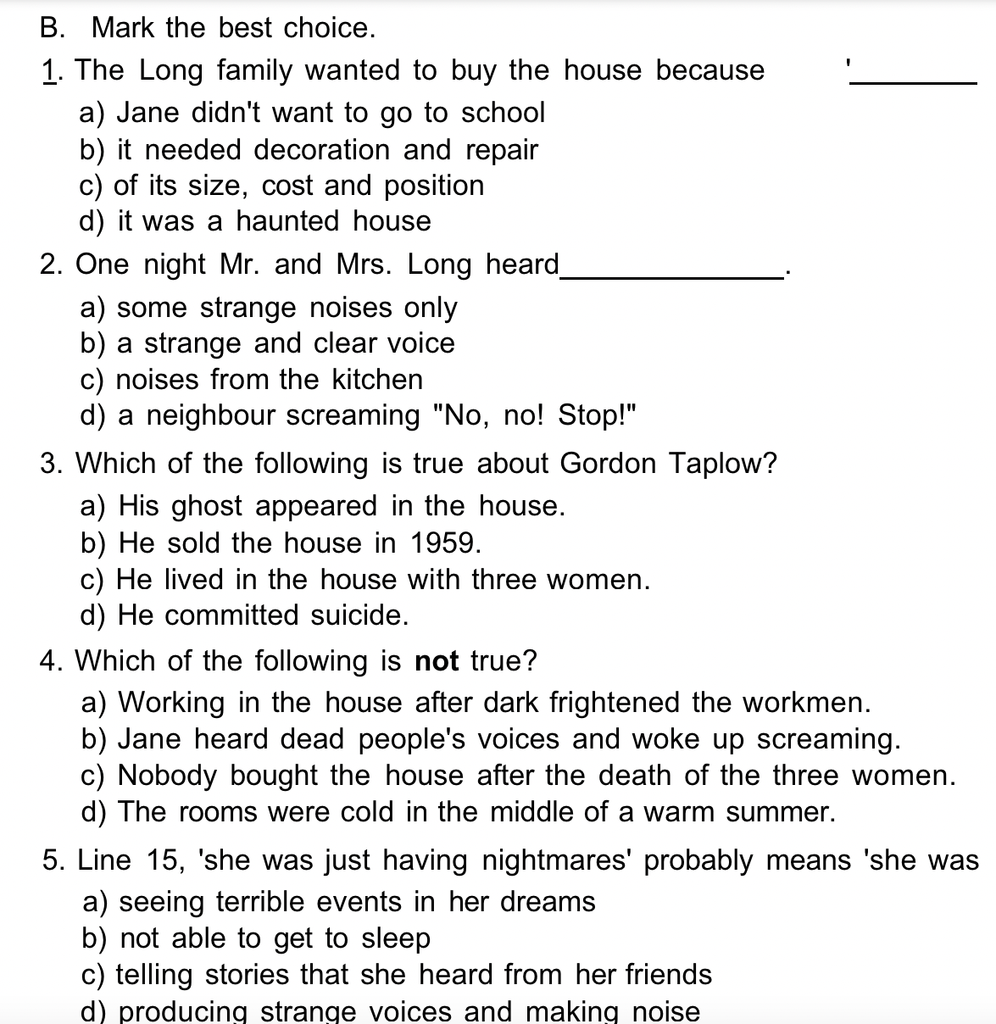
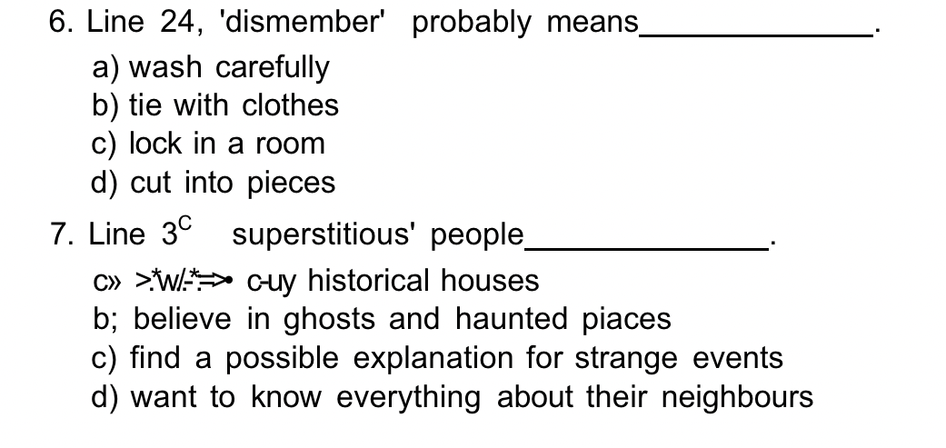

Slide 4
OUR FIRST WORDS

Slide 5
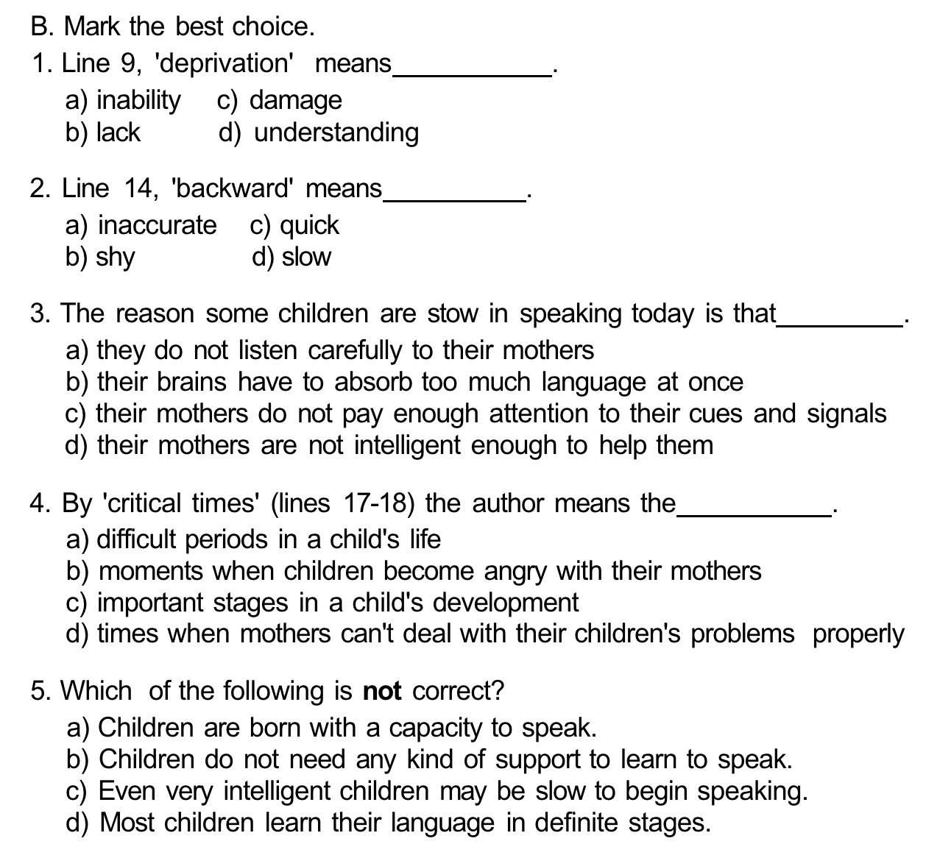

Slide 6
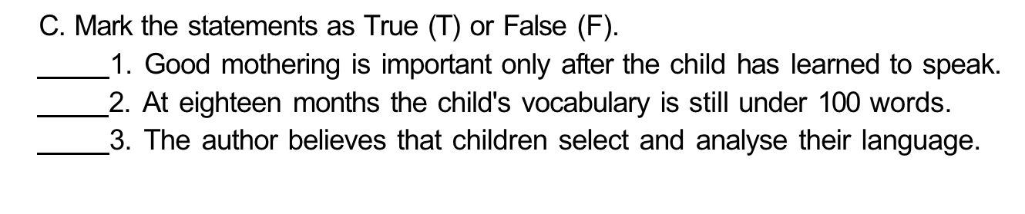

Slide 7
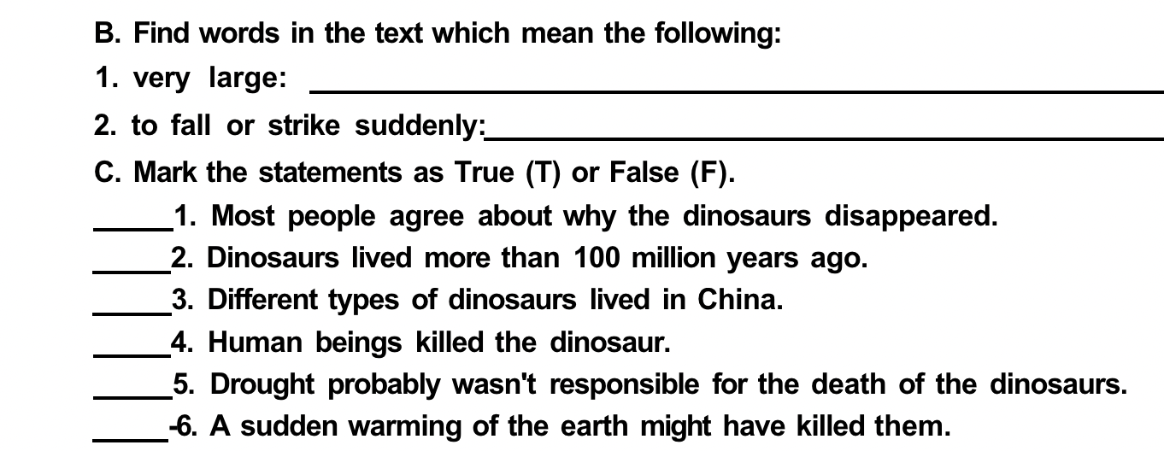
WHAT HAPPENED TO THE DINOSAURS?

